Slide 1
Node-Centric Community Detection
Nodes satisfy different properties
  Complete Mutuality
    cliques
  Reachability of members
    k-clique
  Nodal degrees
    k-core
Commonly used in traditional social network analysis
Here, we discuss some representative ones

Slide 2
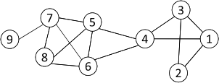
Complete Mutuality: Cliques
Clique: a maximum complete subgraph in which all nodes are adjacent to each other
NP-hard to find the maximum clique in a network
Straightforward implementation to find cliques is very expensive in time complexity
Nodes 5, 6, 7 and 8 form a clique

Slide 3
Finding the Maximum Clique
In a clique of size k, each node maintains degree >= k-1
  Nodes with degree < k-1 will not be included in the maximum clique
Recursively apply the following pruning procedure
  Sample a sub-network from the given network, and find a clique in the sub-network, say, by a greedy approach
  Suppose the clique above is size k, in order to find out a larger clique, all nodes with degree <= k-1 should be removed.
Repeat until the network is small enough
Many nodes will be pruned as social media networks follow a power law distribution for node degrees

Slide 4
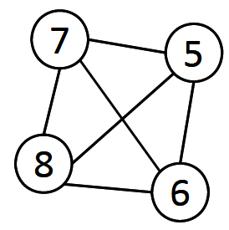
Maximum Clique Example
Suppose we sample a sub-network with nodes {1-9} and find a clique {1, 2, 3} of size 3
In order to find a clique >3, remove all nodes with degree <=3-1=2
  Remove nodes 2 and 9
  Remove nodes 1 and 3
  Remove node 4

Slide 5
Clique Percolation Method (CPM)
Clique is a very strict definition, unstable
Normally use cliques as a core or a seed to find larger communities
CPM is such a method to find overlapping communities
  Input
    A parameter k, and a network
  Procedure
    Find out all cliques of size k in a given network
    Construct a clique graph. Two cliques are adjacent if they share k-1 nodes
    Each connected components in the clique graph form a community

Slide 6
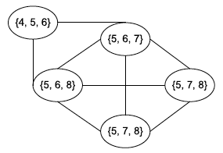

CPM Example
Cliques of size 3:
{1, 2, 3}, {1, 3, 4}, {4, 5, 6}, {5, 6, 7}, {5, 6, 8}, {5, 7, 8},
{6, 7, 8}
Communities:
{1, 2, 3, 4}
{4, 5, 6, 7, 8}

Slide 7
Clustering based on Vertex Similarity
(1) Clustering based on vertex similarity
Apply k-means or similarity-based clustering to nodes
Vertex similarity is defined in terms of the similarity of their neighborhood
Structural equivalence: two nodes are structurally equivalent iff they are connecting to the same set of actors
Structural equivalence is too restrict for practical use.
Nodes 1 and 3 are structurally equivalent;
So are nodes 5 and 6.

Slide 8

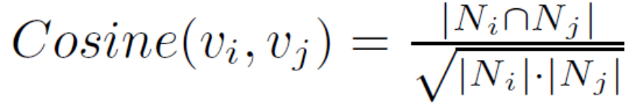


Vertex Similarity
(1) Clustering based on vertex similarity
Jaccard Similarity
Cosine similarity

Slide 9
Kernighan-Lin algorithm
The Kernighan-Lin algorithm is a greedy heuristic for graph partitioning
We begin with an initial (possibly random) partition of the vertices
  At each step we examine every pair of nodes (i,j), where i and j belong to different groups
    If swapping i and j has the smallest effect on the cut size – i.e., maximum decrease or least increase – we swap i and j
  We repeat the above process by considering all pairs across groups but not ones including vertices that have already been swapped
  Once all swaps have been completed, we go through all the different states the network passed through and choose the state

Slide 10
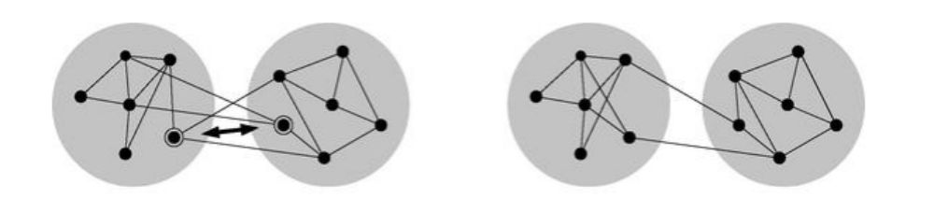
Kernighan-Lin algorithm
We can repeat this algorithm for many rounds
  At each round we start with the best division found in the previous round
  If no improvement of the cut size occurs during the new round the algorithm terminates
Different initial assignments can give different final partitioning,
  We can run the algorithm several times and pick the best solution

Slide 11
Kernighan-Lin algorithm
Despite being straightforward Kernighan-Lin algorithm is slow
At every round the number of swaps is equal to the size of the smaller of the groups → O(n)
At every step of every round we have to check all the possible pairs of nodes that belong to different groups and we have not yet swapped → O(n²)
  For each of these pairs we need to determine what is the change in the cut size if we swap them

Slide 12
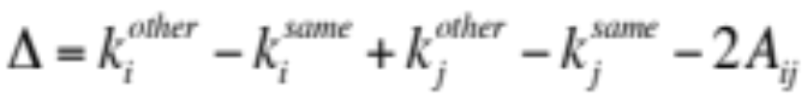
Kernighan-Lin algorithm
If k_{i}^{same} are the number of edges that node i has with vertices belonging to the same group and k_{i}^{other} are the edges i has across groups, then the total change in the cut size if we swap i and j is:
Evaluation of the above expression depends on the way we store the network
  Adjacent list: O(m/n)
  With some tricks and with adjacent matrix: O(1)
Nevertheless, the overall running time is O(n³) (or O(mn²) for sparse networks)
Notes:
The number of rounds required is not well understood how it varies with the network size. However, in typical applications is small.

Slide 13


Modularity Maximization
(5) Modularity maximization
Modularity measures the strength of a community partition by taking into account the degree distribution
Given a network with m edges, the expected number of edges between two nodes with degrees d_{i} and d_{j} is
Strength of a community:
Modularity:
A larger value indicates a good community structure
The expected number of edges between nodes 1 and 2 is
3*2/ (2*14) = 3/14
Given the degree distribution

Slide 14
Other modularity maximization methods
Simulated annealing
Genetic algorithms
Greedy algorithms
  We begin with every node belonging to a different community
  At every step we combine the pair of groups whose amalgamation gives the biggest increase in modularity, or the smallest decrease if no choice gives an increase
  Eventually all vertices are combined into a single group
  We then trace back the states over which the network passed and we select the one with the highest value of modularity
  Time complexity O(nlog²n)
    The modularity achieved with greedy algorithms is slightly lower but it is much faster compared to the other two approaches

Slide 15
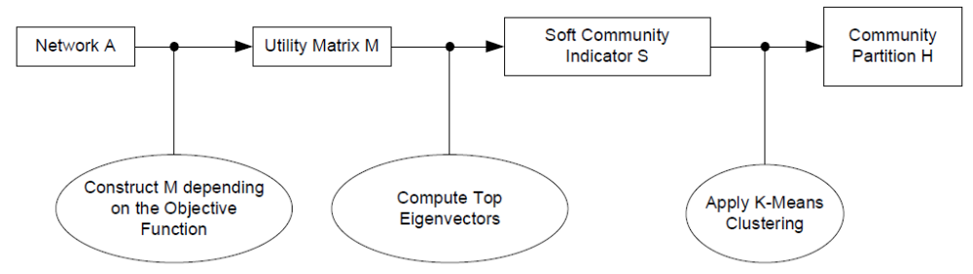

A Unified View for Community Partition
Latent space models, block models, spectral clustering, and modularity maximization can be unified as
Reference: http://www.cse.ust.hk/~weikep/notes/Script_community_detection.m

Slide 16
Hierarchy-Centric Community Detection
Goal: build a hierarchical structure of communities based on network topology
Allow the analysis of a network at different resolutions
Representative approaches:
  Divisive Hierarchical Clustering (top-down)
  Agglomerative Hierarchical clustering (bottom-up)

Slide 17
Divisive Hierarchical Clustering
Divisive clustering
  Partition nodes into several sets
  Each set is further divided into smaller ones
  Network-centric partition can be applied for the partition
One particular example: recursively remove the “weakest” tie
  Find the edge with the least strength
  Remove the edge and update the corresponding strength of each edge
Recursively apply the above two steps until a network is decomposed into desired number of connected components.
Each component forms a community

Slide 18
Edge Betweenness
The strength of a tie can be measured by edge betweenness
Edge betweenness: the number of shortest paths that pass along with the edge
The edge with higher betweenness tends to be the bridge between two communities.
The edge betweenness of e(1, 2) is 4 (=6/2 + 1), as all the shortest paths from 2 to {4, 5, 6, 7, 8, 9} have to either pass e(1, 2) or e(2, 3), and e(1,2) is the shortest path between 1 and 2
Notes:
Nodes 4-9 have two paths to reach Node2: e(1,2) and e(2,3), hence, 6/2 = 3, Node 3 can reach Node 2 directly, and Node 1 reaches Node 2 via e(1,2). Hence, edge betweenness of e(1,2) is 4.

Slide 19
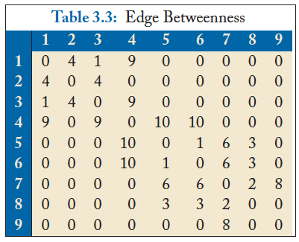
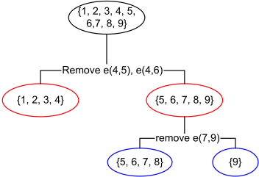
Divisive clustering based on edge betweenness
Initial betweenness value
After remove e(4,5), the betweenness of e(4, 6) becomes 20, which is the highest;
After remove e(4,6), the edge e(7,9) has the highest betweenness value 4, and should be removed.
Idea: progressively removing edges with the highest betweenness

Slide 20
Cut
(4) Spectral clustering
Most interactions are within group whereas interactions between groups are few
community detection → minimum cut problem
Cut: A partition of vertices of a graph into two disjoint sets
Minimum cut problem: find a graph partition such that the number of edges between the two sets is minimized

Slide 21
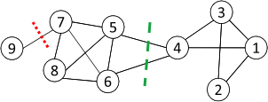


Ratio Cut & Normalized Cut
(4) Spectral clustering
Minimum cut often returns an imbalanced partition, with one set being a singleton, e.g. node 9
Change the objective function to consider community size
C_{i,}: a community
|C_{i}|: number of nodes in C_{i}
vol(C_{i}): sum of degrees in C_{i}

Slide 22


Ratio Cut & Normalized Cut Example
(4) Spectral clustering
For partition in red:
For partition in green:
Both ratio cut and normalized cut prefer a balanced partition

Slide 23



Spectral Clustering
(4) Spectral clustering
Both ratio cut and normalized cut can be reformulated as
Where
Spectral relaxation:
Optimal solution: top eigenvectors with the smallest eigenvalues
graph Laplacian for ratio cut
normalized graph Laplacian
A diagonal matrix of degrees
Reference: http://www.cse.ust.hk/~weikep/notes/clustering.pdf

Slide 24
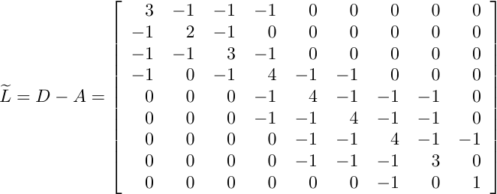
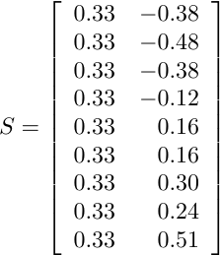
Spectral Clustering Example
(4) Spectral clustering
Two communities:
{1, 2, 3, 4} and {5, 6, 7, 8, 9}
The 1st eigenvector means all nodes belong to the same cluster, no use
k-means
Centered matrix
Notes:
The 1st eigenvector is discarded

